Slide 1
Analysis of Cereals data USING R
Submitted by : Sarang Dani
Submitted on : 29th Apr’18
Contact no. : 9860636291

Slide 2
What the data is about?
This datafile contains nutritional information and grocery shelf location for 77 breakfast cereals.
This includes the details on contents like Calories, Protein, Fats, Fibre etc. alongwith the Name of Manufacturer, Shelf location at Grocery location and the Consumer report rating.
Now, the research does recommend an ideal composition of a “Healthy Breakfast” and the data already includes the “Ratings” from Consumer reports.
However; the project idea is to develop one's own rating system and find which cereal is the most healthy for you.
This presentation takes you through some analytical steps employed using R graphs, while we try to arrive at the solution of this million dollar question –
“Which one is the best Cereal for me?”

Slide 3
Important variables
Manufacturer’s Offerings
Product Range
Consumer’s Expectations
Calorie Requirement Segment
Ease in accessibly
Consumer Report
Influencing factors
Specific Segment
Share
Specific nutritional needs
Any visible patterns

Slide 4

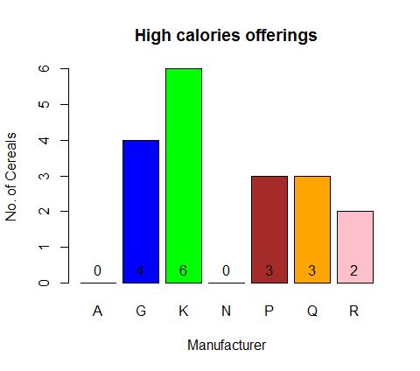
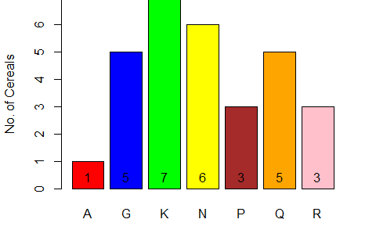
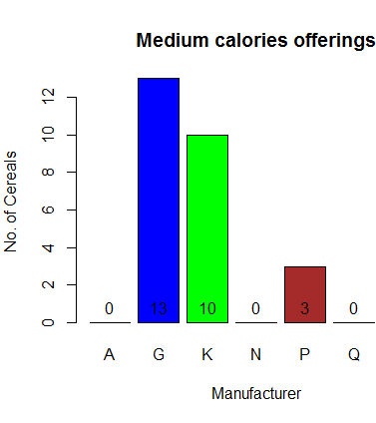
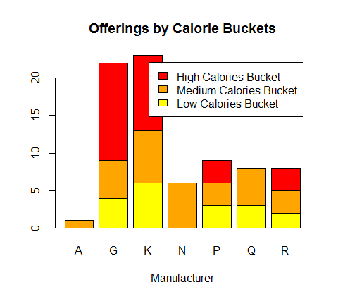
How is the calorie-wise spread?
Low calorie offerings
Low Calories > Medium Calories > High Calories
“Low Calories” is the only segment where all the 7 manufacturers have their offerings
Only a couple of Manufacturers – G & P ; are fairly spread across the range.
Only a couple of Manufacturers – A & N ; offer in one specific segment only
Overall Calorie-wise Offerings

Slide 5
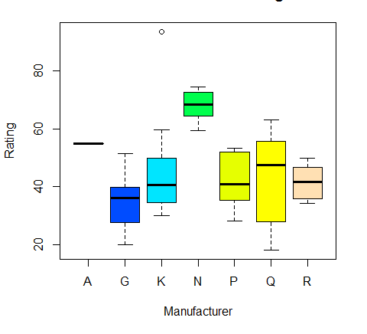
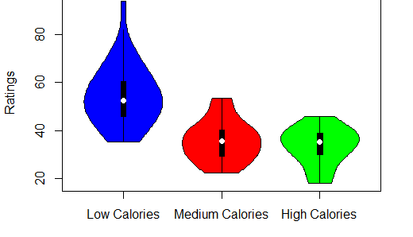
Ratings vs Manufacturer ratings vs calories
Ratings are inversely proportional to Calorie levels
Though offered in limited segment, N has got all its offerings highly rated unlike others
The Manufacturer G lies down in terms of ratings across it offers
The Manufacturer Q is fairly spread in terms of ratings across it offers

Slide 6
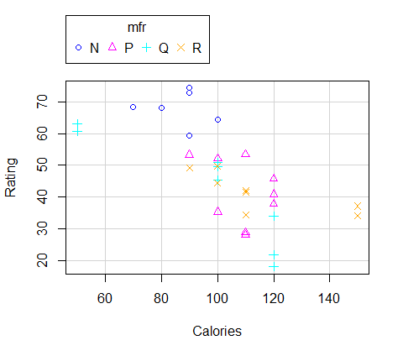
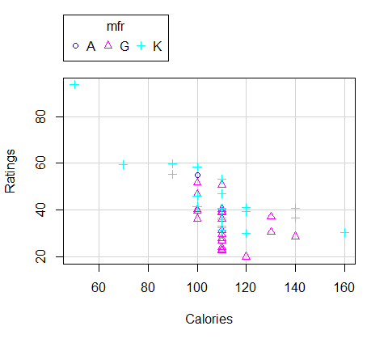
Ratings vs calories
The adjoining scatterplots again depict an Inverse relationship between the Ratings and the Calories.
Manufacturer N exclusively offers Low Calorie cereals and completely dominates the segments in terms of ratings.
G & P are the only two manufacturers who offer the cereals across the whole range

Slide 7
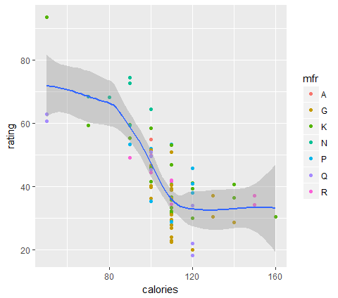


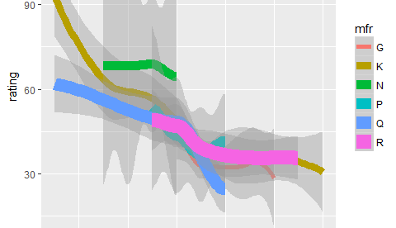

How ratings and calories are inversely proportional?

Slide 8
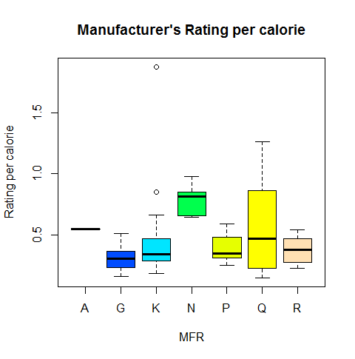
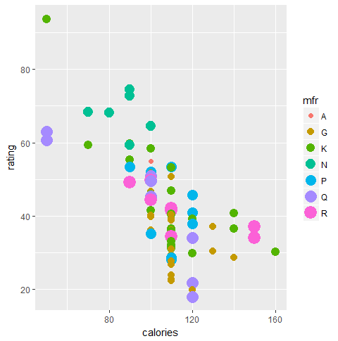
Manufacturer vs rating vs calories
The boxplot on RHS shows the Manufacturers’ standings in terms of “Rating per Calorie”.
The manufacturer “N” scores the highest again followed by “Q”.
The scatterplot on the LHS shows how the Ratings and Calories are spread across various Manufacturers.
We can again validate our finding about “N” being the highest rated, G & K being the universally spread Manufacturer.

Slide 9
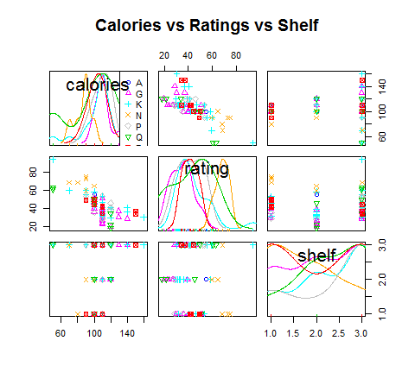
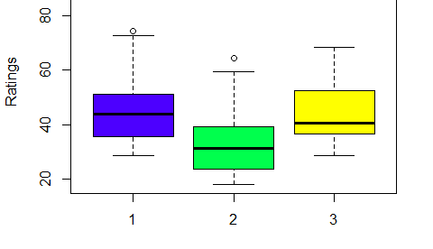
Shelf vs ratings vs calories
We see a good marketing perspective in relation between Ratings and Shelf. The high rated cereals are put either on 1st or 3rd shelf.
On the similar lines, the high calories cereals have been placed on 3rd shelf while the low calorie ones are put on 1st shelf.
The adjoining boxplot also shows that the better rated cereals are either from Low or High calorie buckets.

Slide 10
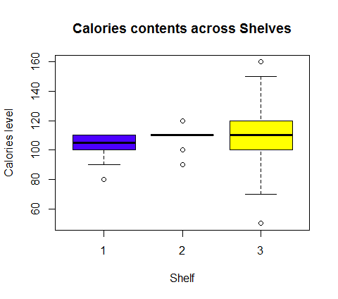
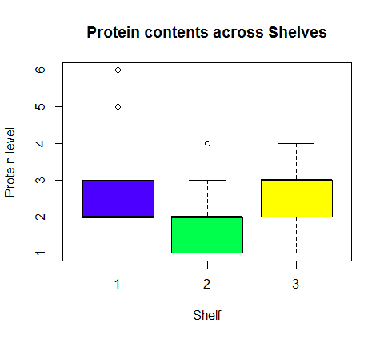
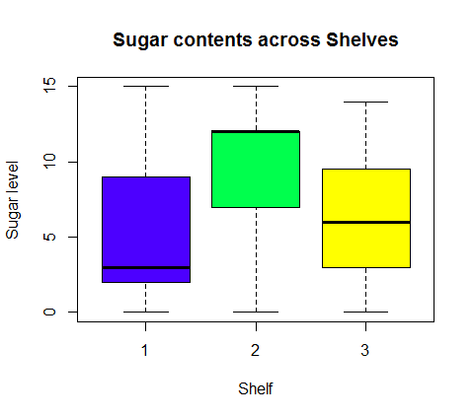
Shelf position vs ingredients
Once again, we get to see a good marketing perspective between Calorie and Sugar content. The high-sugar content cereals are placed in 2nd Shelf considering the increasing awareness among the customers.
High Protein cereals on the other hand, appear to have found the place in 1st and 3rd shelf.

Slide 11
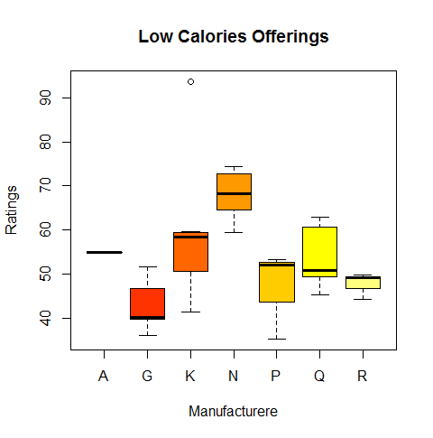
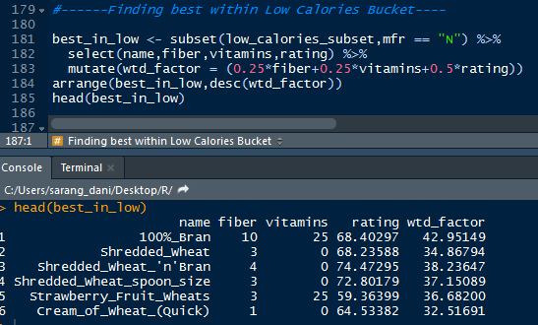
Finding the best among low calories
We see that “N” seems to have got the relatively higher rating in the group.
Within “N”, we see that “100%_Bran” containing the ideal combination of fiber, Vitamins alongwith the Consumer report’s rating.

Slide 12
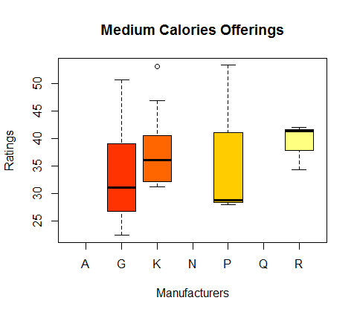
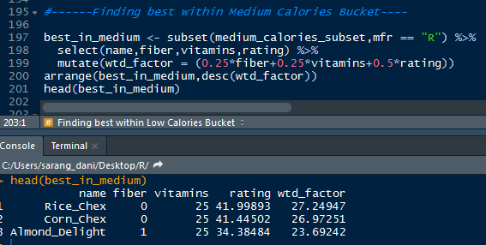
Finding the best among medium calories
We see that “R” seems to have got the relatively higher rating in the group.
Within “N”, we see that “Rice_Chex” containing the ideal combination of fiber, Vitamins alongwith the Consumer report’s rating.

Slide 13
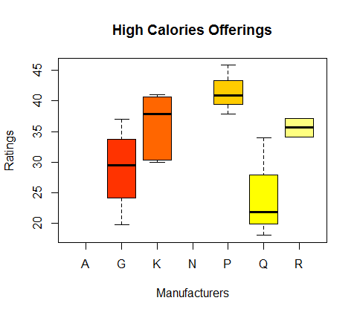
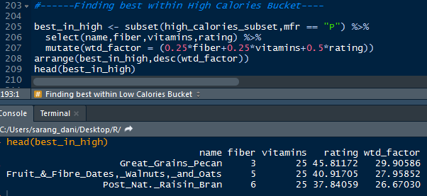
Finding the best among high calories
We see that “P” seems to have got the relatively higher rating in the group.
Within “N”, we see that “Great_Grains_Pecan” containing the ideal combination of fiber, Vitamins alongwith the Consumer report’s rating.

Slide 14
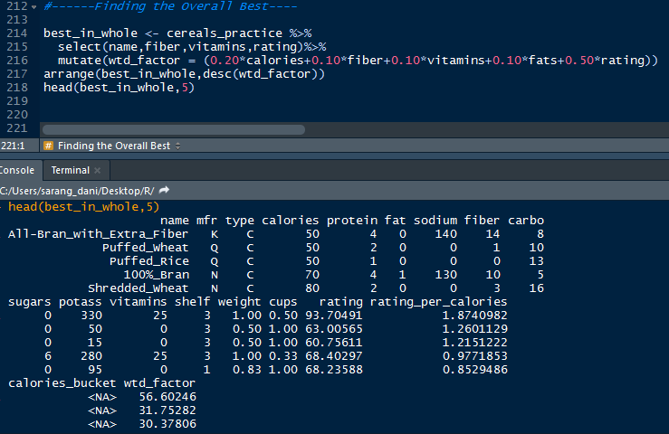
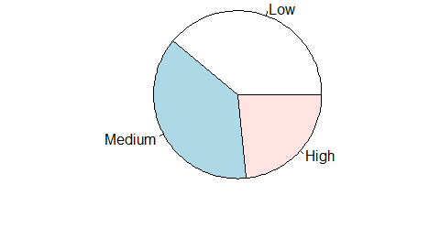
All_bran_with_extra_fiber comes out to be the best among overall lot in terms of inclusiveness of all necessary ingredients in adequate proportion

Slide 15
have healthy breakfast and… stay healthy…☺ Thank you…!

